Slide 1
The Apps Project
Problem:
Did Apple Store apps receive better reviews than Google Play apps?
Stages of the project:
Sourcing and loading
Cleaning, transforming, and visualizing
Modelling
Evaluating and concluding

Slide 2
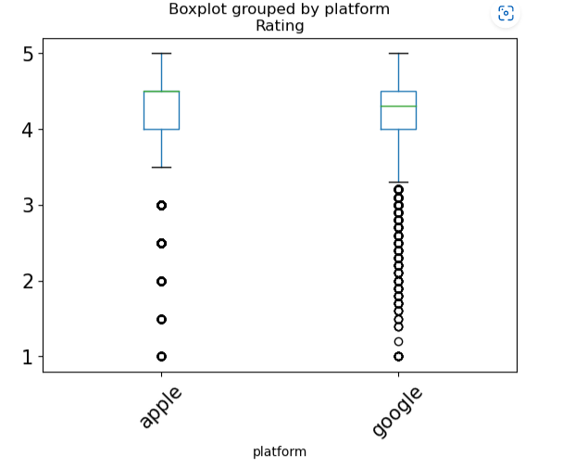
Cleaning and Transforming
Selected features are category, rating, reviews, and price
Convert categorical data types to numerical data types, remove string and “$” in Price column
Add platform column, matching column name in preparation for joining two datasets
Eliminate NaN values and only kept rows with numbers of reviews greater than zero
The boxplot on the left side is the rating of both platforms after cleaning and transforming
The average difference between the two platforms is 0.19

Slide 3
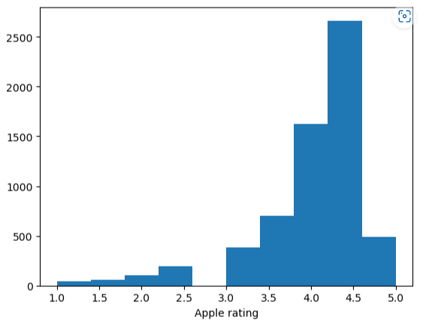
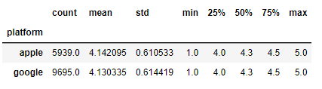
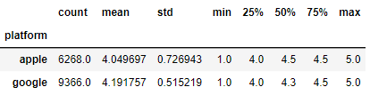
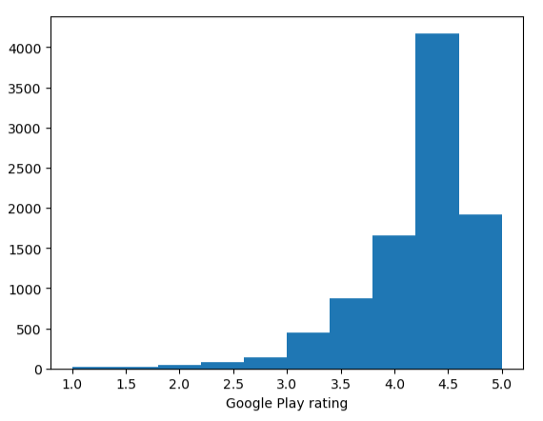
Modeling
Hypothesis formulation
Null hypothesis: the observed difference in the mean of Apple and Google Play apps is due to chance ( not due to the platform)
Alternative hypothesis: the observed difference in mean of Apple and Google Play apps is due to platform
Permutation test
As shown on the histograms on the right, the distributions are not normally distributed, we are going to use a non-parametric test
Create a permutation column by shuffling the Rating column. The difference in mean for permutation is 0.0011. It looks different from the observed difference of 0.14206 which now looks significant. This suggests that the NULL hypothesis could be wrong but will do more testing before jumping to the conclusion
Mean from permutation column Mean from Rating column
Data for the Permutation test
To confirm that the Null hypothesis is wrong, perform permutation 10,000 times on the Rating column and take the average difference between two platforms for each permutation and store them in an array

Slide 4
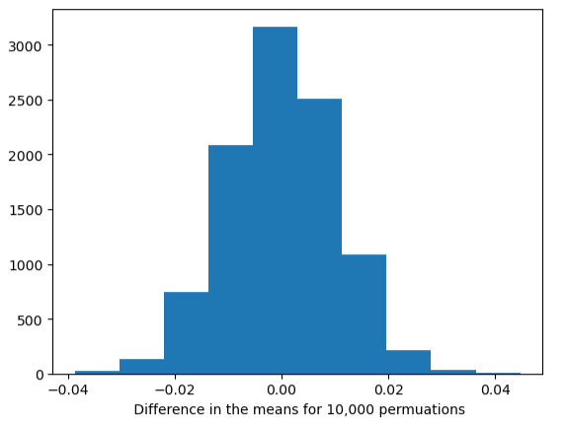
Evaluating and Conclusion
The mean difference distribution from 10,000 permutations is shown on the plot. All data points are far less than the observed difference of 0.14
The observed difference in the mean of Apple and Google Play apps is due to the platform
Apple Store apps do not receive better reviews than Google Play apps so will choose Google apps.

